Slide 1


Social Buzz Insights

Slide 2


Today's agenda
Project recap
Problem
The Analytics team
Process
Insights
Summary

Slide 3


Social Buzz is a fast growing technology unicorn that needs to adapt quickly to its global scale.
Accenture has begun a 3 month POC focusing on these tasks:
An audit of Social Buzz’s big data practice
Recommendations for a successful IPO
Analysis to find Social Buzz’s top 5 most popular categories of content.
Project Recap

Slide 4


Problem
Over 1,00,000 posts per day!
36,500,000 pieces of content per year!
How to Capitalize on the data when it is soo much?
Analyse to find Social Buzz’s top 5 most popular cayegories of content

Slide 5



Andrew Flaming
Chief Technical Architect
The Analytics team
Marcus Rompton
Senior Principal
Maithili Dhamane
Data Analyst

Slide 6

Process
1
Business Understanding
2
Data Cleaning
3
Data Modelling
4
Data Analysis
5
Uncover Insights

Slide 7


Insights
1897
Reactions of the most popular category:
animal
January
month has the maximum number of reactions
16
unique categories

Slide 8
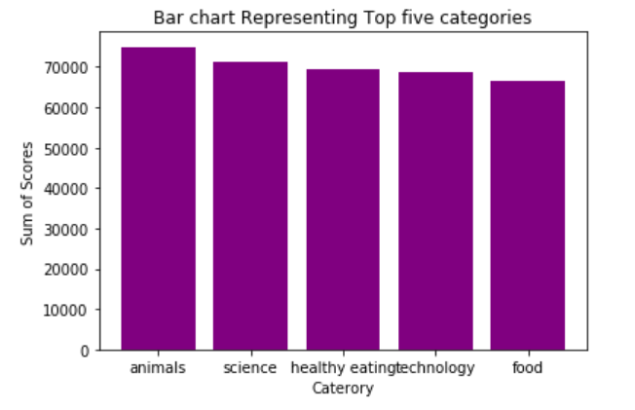

Slide 9
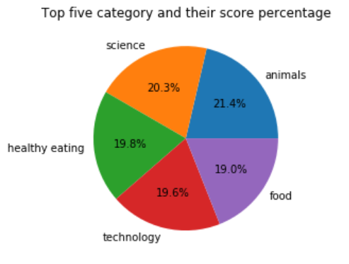

Slide 10


Thus we analyzed the top five popular category with animals being at the top.
So we can infer that people are more inclindes towards science and technology nature and food , therefore social buzz much create more of the content of this type to increase its traffic
Summary

Slide 11

Thank you!
ANY QUESTIONS?

